Slide 1
CS 4530 Software Engineering
Module 10: Distributed Systems Architectures
Jonathan Bell, Adeel Bhutta, Mitch Wand
Khoury College of Computer Sciences
© 2022, released under CC BY-SA

Slide 2
Learning Objectives for this Lesson
By the end of this lesson, you should be able to…
Recognize common software architectures
Understand tradeoffs of scalability, performance, and fault tolerance between these architectures
Describe what makes web services RESTful, and implement a REST API

Slide 3

Distributed Software Architectures
Goal: abstract details away into reusable components
Enables exploration of design alternatives
Allows for analysis of high-level design before implementation
Match system requirements to quality attributes of common architectural patterns
Notes:
In today’s lecture, we will discuss common distributed systems architectures.
(Read slide)
In the same way that object oriented design patterns let us reason about trade-offs in common problems, software architectures let us reason about tradeoffs to common problems, but at a much larger scale.
For example, consider the layout of buildings on campus: determining where to put what building and how people flow between them is an important step of design.

Slide 4




Review: Distributed Systems Must Compromise
Constraints: number of nodes, network links
SF
NY
Even if cross-city links are fast and cheap (are they?)
Still that pesky speed of light…
DC
LONDON
Notes:
For large, complex systems, the architectures must inevitably involve some compromise. As we discussed in the last module, even with infinity resources, there will still be fundamental limitations to our system’s performance.
In summary: the key challenges that distributed systems need to design around are:
greater potential to see at least one component fail (given independent failure probabilities and increase in number of components)
Now we can also see the network link fail (not just a machine fail)
Limited high-speed networks between sites (limited throughput)
Speed of light

Slide 5

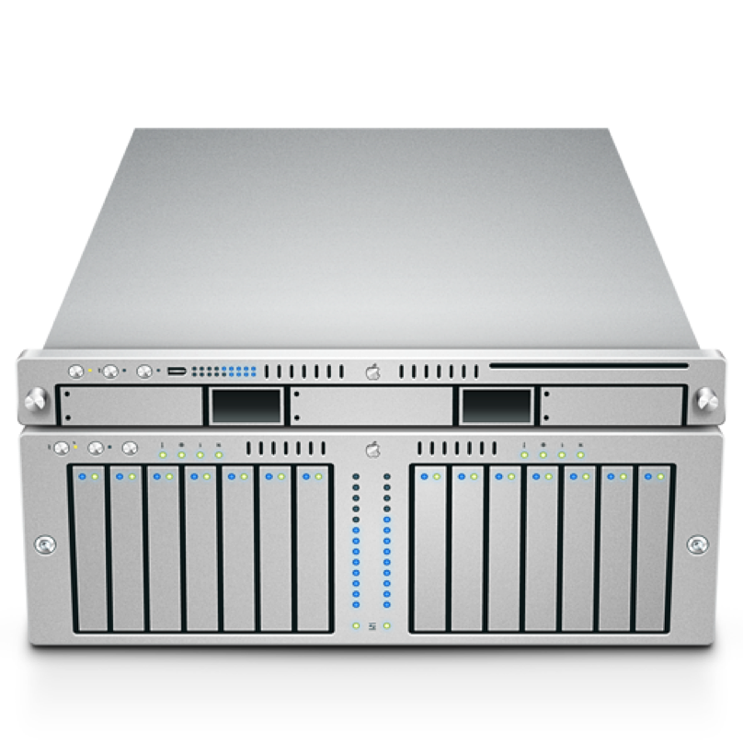
Replicated Systems Must Compromise
Consistency or availability?
Consistent:
Maintain that “single server” behavior - all clients see the same values regardless of failures
At least one server can’t safely respond in case of failure
Available:
Different servers might diverge
Ignores network failures, as long as client can reach server, still offer a response
A
B
A
B
Notes:
Particularly when our distributed systems involve replication, we also discussed the challenge that they must make between consistency: Maintaining that “single server” behavior - all clients see the same values regardless of failures - and availability: allowing all nodes to continue operating in the presence of a single failure.
Remember: DNS makes the compromise that it is OK to see the wrong value.
Software architectures will let us see common solutions to the question of how to structure our system, given different goals.

Slide 6
The Monolith Architecture Relies on a Single Server
Simplest answer to consistency problem: have only one server, one source of truth
Still “distributed” in that we have many clients
Sacrifices:
Scalability
Performance
Fault tolerance
Server
Client
Client
Client
Client
Client
Notes:
While most distributed systems involve multiple “servers” coordinating to act as one, it is also worthwhile to consider the case of a single server interacting with multiple clients. When considering the system as a whole: the clients *and* the server, there is still some coordination that occurs to implement the system’s goals. We will start with discussing this “monolithic” application as a starting point for examining other common distributed systems architectures.
(Read slide, next slide will have example of a monolithic design and its faults)

Slide 7
NFS is a Monolithic Shared Filesystem
All files are stored on a single server
To list files in a directory, clients make request to server
To read or write files, clients make request to server
Clients might “lock” files to prevent concurrent updates
Assuming that scale, throughput, fault tolerance requirements are relatively low, this is an acceptable architecture
This architecture is the easiest to build fast and correctly
Notes:
To summarize how NFS is a “monolithic system”:
(Read slide)

Slide 8
Monolithic Architectures Struggle to Scale
Challenges with NFS
Scalability - How to go from 10 to 100 to 1,000 clients?
Performance - How to access 100’s of GB of data concurrently?
Fault tolerance - What if server crashes?
Server
Client
Client
Client
Client
Client
Notes:
While the monolithic architecture of NFS is certainly applicable to many use-cases (it is very widely used!), there are limitations to this architecture.
To scale a monolith (like NFS), our single option is to replace our server with a bigger server. Eventually, we will reach a limit of the performance of a single server. By definition, the monolith has a single server, so to break this scaling barrier, we will need a new architecture.
Similarly, the performance of the monolith is limited by the performance of that single node and its network links. If, in this figure, we have 5 clients all trying to read 100GB files concurrently, they will be limited by the total throughput of this one server.
Lastly, we will be quite limited in terms of a fault tolerance story here. If the single server goes down, the whole system goes down.

Slide 9
Replication Alone is Not The Answer
Constraints:
Latency: Speed of light (~1ns/ft)
Throughput: Long-distance links between servers are relatively low throughput (10’s of Gbps, compare to 100’s of Gbps within a single server)
Tradeoffs for replication, particularly over long distances:
Replication will add latency, not reduce it
Usually not enough bandwidth to maintain replication of all data across all nodes
Notes:
To motivate the next architecture that we will discuss, recall two of the constraints in distributed systems from the last module: latency and throughput.
These constraints impose significant tradeoffs for architectures that rely on replication, particularly over long distances.
First: Since replication (with consistency) requires that updates are made to all servers that maintain a replica of that data, replication *adds* latency to reads or writes by requiring that updates are acknowledged by all replicas before committing them.
Second: Given limited network throughput, there is often not enough bandwidth to maintain replication of all data across all nodes.
As a result, most distributed system architectures consider both replication and partitioning.

Slide 10
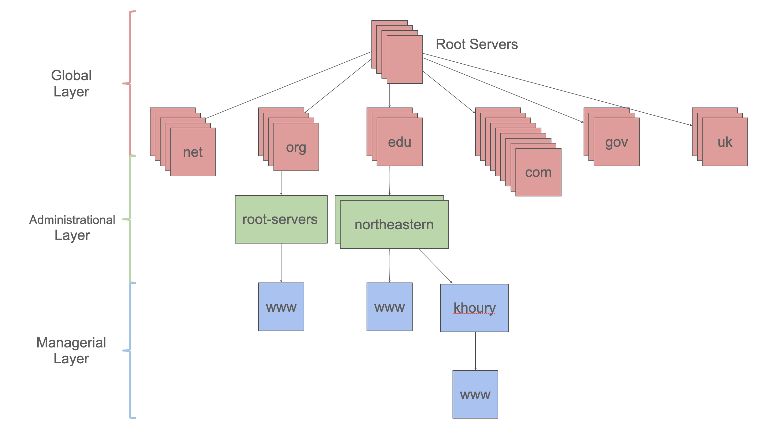
Tiered Architectures Partition Responsibility
Key idea: Partition the system into distinct tiers based on responsibilities
Each tier scales independently of the others - .com need not know about .org
Satisfying a single request may require multiple tiers
DNS is a tiered architecture
Example: scale .com differently from .gov
Notes:
DNS, which we discussed in the last module, is an example of what we call a “tiered” architecture.
(Read slide)

Slide 11
Design Tiers Considering the Structure of Data
Example: GFS (Google File System, c 2010)
Stated requirements: “High sustained bandwidth is more important than low latency. Most of our target applications place a premium on processing data in bulk at a high rate, while few have stringent response time requirements for an individual read or write.”
Server
Key problem: throughput of single server is limited
Client
Client
Client
Client
Client
Notes:
How might we consider applying this idea of partitioning to a network filesystem, like our NFS monolith?
A classic example of tiering distributed filesystems is GFS, the Google File System.
(Read stated requirements)
The key problem is that the throughput of a single server is limited, so we need some way to have multiple servers, so that clients can read/write files on those different servers, allowing for scaling. But how do we coordinate multiple servers?

Slide 12
GFS Tiers Filesystem Metadata and File Chunks
Example: GFS (Google File System, c 2010)
Stated requirements: “High sustained bandwidth is more important than low latency. Most of our target applications place a premium on processing data in bulk at a high rate, while few have stringent response time requirements for an individual read or write.”
Where is file /foo/bar?
GFS Client
GFS Metadata
Metadata tier stores where files are stored, in 128MB chunks
List of chunks and their locations
GFS Client
GFS Client
GFS Client
GFS Client
Chunk tier stores each 128MB chunk, no need for coordination between ChunkServers not storing same chunk
GFS Client
Reads chunks from the specific ChunkServers known to have them
GFS Client
ChunkServer
ChunkServer
ChunkServer
ChunkServer
ChunkServer
ChunkServer
ChunkServer
ChunkServer
ChunkServer
ChunkServer
ChunkServer
ChunkServer
ChunkServer
ChunkServer
ChunkServer
ChunkServer
ChunkServer
ChunkServer
ChunkServer
ChunkServer
ChunkServer
ChunkServer
ChunkServer
ChunkServer
Notes:
To achieve these stated requirements, GFS’ architecture is split into two tiers.
Each file is split into multiple “chunks” of 128MB. A GFS Metadata tier, which knows the names of each of the files, and for each file, knows where the “chunks” are.
The Chunk tier stores each of the 128MB chunks.
For a client to read a file, like “/foo/bar”, it first asks the metadata tier for the list of chunks and the chunk servers that have it. Then, it can directly connect to the relevant chunk servers in the chunk tier and read the file.
The chunk tier can scale extremely efficiently, because supporting more (and bigger) concurrent reads/writes just means that we add more chunk servers. This tiering can be further expanded so that chunks are replicated between multiple chunk servers, creating yet another tier, but getting into the details of GFS further is really the topic of a distributed systems class.
Of course: there might be a bottleneck on the metadata tier: every single request will pass through it (to find which chunk server to talk to). But: the requirements stated that it was OK for there to be a latency to start a large read or write - so this is an adequate design for the requirements. Within Google, GFS has since been replaced by a much more complex system that alleviates this bottleneck, but this design is widely deployed today - the very popular “Hadoop” map/reduce library implements a distributed filesystem “HDFS” which is exactly this one!
Our important takeaway for GFS is that it allows for high-throughput reads and writes by allowing this “chunk” tier to scale with little limitation.

Slide 13
Pipeline Architectures
Big Data (lots of work)
The pieces correspond to stages in the transformation of data in the system
Good for complex straight-line processes where multiple stages applied to different data, concurrently
Each stage in the pipeline takes an input, produces an output: otherwise stateless
Example: Map/Reduce splits data, filters it through stages, then combines
Partition
Stage 1
Stage 1
Stage 1
Stage 1
Stage 1
Stage 2
Stage 2
Stage 2
Stage 2
Stage 2
Stage 3
Stage 3
Stage 3
Stage 3
Stage 3
Combine
Result
Notes:
(Read slide; note that figure on right is map/reduce architecture, showing pipeline through stages)

Slide 14
Pipeline Architectures
Big Data (lots of work)
Scalability/Performance:
Add more machines to process more data in parallel
Limited by bandwidth to transfer inputs/outputs between stages
Fault tolerance: Each stage in pipeline is stateless. If one fails, it can be repeated elsewhere.
Partition
Stage 1
Stage 1
Stage 1
Stage 1
Stage 1
Stage 2
Stage 2
Stage 2
Stage 2
Stage 2
Stage 3
Stage 3
Stage 3
Stage 3
Stage 3
Combine
Result
Notes:
How does a pipeline architecture address our distributed systems requirements and tradeoffs?
Similarly to the tiered architecture, we can scale to support processing more data concurrently by adding more machines. Each machine can process some number of stages concurrently. Because the stages are independent, we can always add more machines to process more data in parallel.
The limitation that we will run into is the bandwidth to transfer the inputs and outputs from each stage in the pipeline to the next.
However, once we recognize this limitation, we can also design systems around it: consider this exact problem of map/reduce running on a lot of data. How do we move that big amount of data to be in the right spot to run a task on it? Map/Reduce is implemented in conjunction with GFS: each filter in the pipeline is run on a chunk server that already has that piece of data.
In terms of fault tolerance, the pipeline architecture improves over the general tiered architecture because it also enforces the requirement that each stage in a pipeline is stateless. If a node fails in the middle of processing some data in a stage of the pipeline, the system could always recover by running that same input through the pipeline again: no data would become corrupted by partial results from the failed computation.

Slide 15
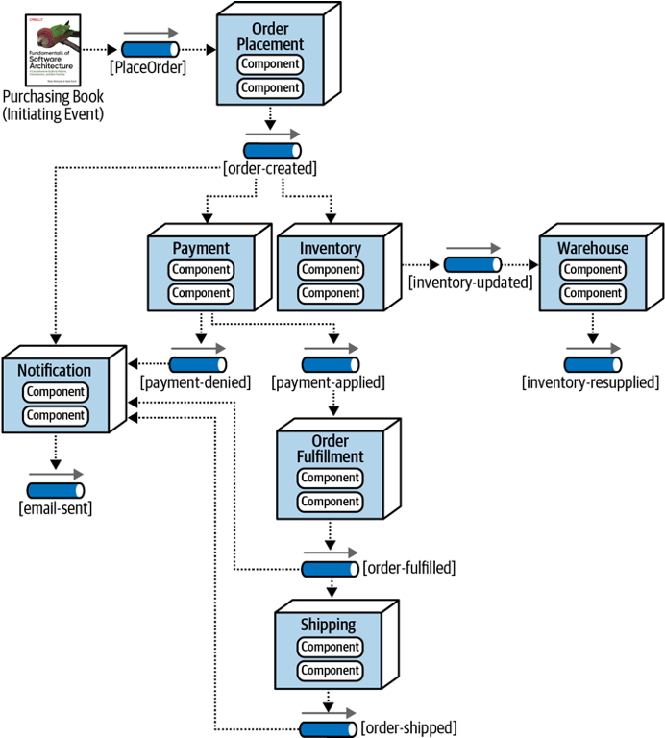
Event-Driven Architectures
Metaphor: a bunch of bureaucrats shuffling papers
Components correspond to stages in the flow of data through the system (not necessarily a straight-line flow)
Very useful for composing other services (bureaucrats)
Each processing unit has an in-box and one or more out-boxes
Each unit takes a task from its inbox, processes it, and puts the results in one or more outboxes.
Stages are typically connected by asynchronous message queues.
Notes:
(Read slide)

Slide 16
Event Driven Architecture: Reliable Real-Time Chat
Requirements: “Must support real-time text chat for 2,000 users exchanging messages. Must have best-effort delivery in real-time, and guarantee that all messages acknowledged are preserved.”
Challenge: Real-time “best-effort” delivery has conflicting requirements (low latency at expense of fault tolerance) with guaranteeing all messages are eventually delivered (fault tolerance at expense of latency)
Client
Client
Sends message
Real Time Chat Service
Delivers instantly to 2,000 clients
Client
Client
Notes:
Event driven architectures are very useful to compose multiple systems together that have different requirements.
For example: How do we design a system like Slack, which needs to support real-time text chat for potentially thousands of users in the same channel. We want those message to be delivered in real-time (with the least possible latency), but will accept potential failures: if some client is slow to respond to acknowledge a message, we should still keep sending the message to the rest of the clients. But, at the same time, we want to ensure that we have an authoritative record that guarantees that all of the chat messages in a channel are recorded in the order in which they were received, with fault tolerance?
These are conflicting requirements. Building one system that does both things seems impossible.
This is where the idea of an event-driven architecture comes into play

Slide 17
Event Driven Architecture: Reliable Real-Time Chat
Requirements: “Must support real-time text chat for 2,000 users exchanging messages. Must have best-effort delivery in real-time, and guarantee that all messages acknowledged are preserved.”
Responsibilities/processing units:
“Real time” component optimizes for speed and availability sacrificing fault-tolerance
“Persistence” component optimizes for fault-tolerance, sacrificing speed and availability
Event queue service receives events, dispatches to both processing units and is fault tolerant
Notes:
The core concept of event-driven architectures is to separate responsibilities (or tiers, if you will) by processing units. We can take these two conflicting requirements and organize them into two processing units around these responsibilities:
Real time processing unit optimizes for speed and availability of distributing all messages in real time to as many clients as possible. It makes no fault tolerance guarantees - if parts of it fail, clients will not get their messages in real time. However, the clients could still retrieve them (perhaps somewhat slower) from…
Persistence processing unit, which optimizes for fault-tolerance, sacrificing speed and availability. Every message that is received by the persistence processing unit is guaranteed to be available in the future if clients ask for it.
By using the pattern of an event-driven architecture, we can then add an event queue service that receives the chat messages from clients and dispatches them to both processing units. The event queue will be fault tolerant in that it has a buffer of messages that have been received, but not yet processed by the “persistence” component. As the persistence component archives the messages, the buffer can be freed.

Slide 18
Event Driven Architecture: Reliable Real-Time Chat
“Real time” component optimizes for speed and availability sacrificing fault-tolerance
“Persistence” component optimizes for fault-tolerance, sacrificing speed and availability
Reliable message queue buffers new chat messages
Real Time Chat Service
Client
Client
Sends message
Reliable message queue (e.g. RabbitMQ)
Fast, not-fault-tolerant real-time service (e.g. Redis)
Delivers instantly to 2,000 clients
Client
Reliable database (e.g. PostgreSQL)
Client
Notes:
Here is a high-level architecture diagram that shows how we might go about implementing this real time chat service.
Messages flow into our system, and are delivered to both components - the real time service and the persistence service.
We do not show the details of how each of the components is implemented (that’s a topic for another class), but list an example of the kinds of off-the-shelf infrastructure that are likely to be used by each component.

Slide 19
Event-Driven Architecture Tradeoffs
Scalability:
Scale each processing unit separately
Add more processing units at a marginal cost
Performance:
Message queue usually very high-throughput, relies on event processors to pick up and process messages or queue can overflow
Fault tolerance:
Message queue can implement a buffer to ensure fault tolerance
Notes:
(Read slide)

Slide 20
Microservice Architectures
Organize implementation around components (responsibilities)
Each component is implemented independently
Each component is
independently replaceable,
independently updatable
Components can be built as libraries, but more usually as web services
Services communicate via well-defined protocol like REST
Notes:
(Read slide)

Slide 21
Microservices: Schematic Example
Different languages, different operating systems
NodeJS, MongoDB
Google Service
Java, MySQL
Todos
Logins
Mailer
Mod 1
Mod 2
Mod 3
Productivity App
REST service
REST service
REST service
Database
Database
Database
Frontend
REST
Search Engine
Analytics
Social Crawler
“Dumb”
App Server
Mod 4
Mod 5
Mod 6
REST service
REST service
REST service
Database
Database
Database
Java, Neo4J
C#, SQLServer
Python, MongoDB
Notes:
Here is an example of a micro services architecture for a productivity application. There are multiple components to this application. Each component is shown as a grey box, and is a micro service.
(Note the separation of responsibilities to entirely different services that only connect over a well-defined API)
Common question: How is this different from the event-based system? A: Picture looks very similar. Difference is that the services communicate directly with each other over a well-defined API, rather than having a message queue that routes the messages to the different services.

Slide 22
Microservice Advantages and Disadvantages
Advantages
services may scale differently, so can be implemented on hardware appropriate for each (how much cpu, memory, disk, etc?). Ditto for software (OS, implementation language, etc.)
services are independent (yay for interfaces!) so can be developed and deployed independently
Disadvantages
service discovery?
should services have some organization, or are they all equals?
overall system complexity

Slide 23
Microservices are (a) highly scalable and (b) trendy
Microservices at Netflix:
100s of microservices
1000s of daily production changes
10,000s of instances
BUT:
only 10s of operations engineers
https://medium.com/refraction-tech-everything/how-netflix-works-the-hugely-simplified-complex-stuff-that-happens-every-time-you-hit-play-3a40c9be254b

Slide 24
Microservices vs Monoliths
Martin Fowler’s Microservices Guide - https://martinfowler.com/microservices/
higher is better
Notes:
It is hard to say generally when it makes sense to create a micro service architecture vs a more monolithic one. For very simple systems, the micro service architecture might simply be adding complexity. But, theoretically, as the system grows in complexity, the micro service abstraction improves understanding and productivity

Slide 25
How Do Components/Services Communicate?
Ideally, a magic abstraction: remote procedure call (RPC) should make the separation transparent
There are many variations of RPC
CORBA, RMI, SOAP, and more
The most common form of RPC today is called REST
Caller Machine
Callee Machine
User Code
User Code
local call
local call
work
local return
local return
Notes:
(Read slide)

Slide 26
REST: Representational State Transfer
Defined by Roy Fielding in his 2000 Ph.D. dissertation
“Throughout the HTTP standardization process, I was called on to defend the design choices of the Web. That is an extremely difficult thing to do... I had comments from well over 500 developers, many of whom were distinguished engineers with decades of experience. That process honed my model down to a core set of principles, properties, and constraints that are now called REST.”
Not just a transport protocol, not a protocol definition language: a design philosophy
Interfaces that follow REST principles are called RESTful

Slide 27


REST Principles
Single Server - As far as the client knows, there’s just one
Stateless - Each request contains enough information that a different server could process it (if there were multiple…)
Uniform Cacheability - Each request is identified as cacheable or not.
Uniform Interface - Standard way to specify interface
Clients
External Cache
Internal Cache
Web Servers
Client sees none of this!
Misc Services
App Servers
Database servers

Slide 28
Nouns are represented as URIs
In a RESTful system, the server is visualized as a store of resources (nouns), each of which has some data associated with it.
URIs represent these resources
Examples:
/cities/losangeles
/transcripts/00345/graduate (student 00345 has several transcripts in the system; this is the graduate one)
Anti-examples:
/getCity/losangeles
/getCitybyID/50654
/Cities.php?id=50654
We prefer plural nouns for toplevel resources, as you see here.
Useful heuristic: if you were keeping this data in a bunch of files, what would the directory structure look like?
But you don't have to actually keep the data in that way.

Slide 29
Verbs are represented as http methods
In REST, there are four things you can do with a resource
POST: requests the server to create a resource
there are several ways in which the value for the new resource can be transmitted (more In a minute)
GET: requests the server to respond with a representation of the resource
PUT: requests the server to replace the value of the resource by the given value
DELETE: requests the server to delete the resource

Slide 30
You say you want parameters?
There are at least 3 ways to associate parameters with a request:
path parameters. These specify portions of the path to the resource. For example, your REST protocol might allow a path like
/transcripts/00345/graduate
query parameters. These are part of the URI and are typically used as search items. For example, your REST protocol might allow a path like
/transcripts/graduate?lastname=covey&firstname=avery
body parameters. You can put additional parameters or information in the body, using any coding that you like.

Slide 31
Example interface #1: a todo-list manager
Resource: /todos
GET /todos - get list all of my todo items
POST /todos - create a new todo item (data in body)
Resource: /todos/:todoItemID
:todoItemID is a path parameter
GET /todos/:todoItemID - fetch a single item by id
PUT /todos/:todoItemID - update a single item (new data in body)
DELETE /todos/:todoItemID - delete a single item

Slide 32
Example Interface #2: a database of transcripts
Remember the heuristic: if you were keeping this data in a bunch of files, what would the directory structure look like?
POST /transcripts
-- adds a new student to the database,
-- returns an ID for this student.
-- requires a body parameter 'name', url-encoded (eg name=avery)
-- Multiple students may have the same name.
GET /transcripts/:ID
-- returns transcript for student with given ID. Fails if no such student
DELETE /transcripts/:ID
-- deletes transcript for student with the given ID, fails if no such student POST /transcripts/:studentID/:courseNumber
-- adds an entry in this student's transcript with given name and course.
-- Requires a body parameter 'grade', url-encoded
-- Fails if there is already an entry for this course in the student's transcript
GET /transcripts/:studentID/:courseNumber
-- returns the student's grade in the specified course.
-- Fails if student or course is missing.
GET /studentids?name=string
-- returns list of IDs for student with the given name
Didn't seem to fit the model, sorry ☹

Slide 33
Specify REST APIs using OpenAPI
/towns/{townID}/viewingArea:
post:
operationId: CreateViewingArea
responses:
'204':
description: No content
'400':
description: Invalid values specified
content:
application/json:
schema:
$ref: '#/components/schemas/InvalidParametersError'
description: Creates a viewing area in a given town
tags:
- towns
security: []
parameters:
- description: ID of the town in which to create the new viewing area
in: path
name: townID
required: true
schema:
type: string
- description: |-
session token of the player making the request, must
match the session token returned when the player joined the town
in: header
name: X-Session-Token
required: true
schema:
type: string
requestBody:
description: The new viewing area to create
required: true
content:
application/json:
schema:
$ref: '#/components/schemas/ViewingArea'
description: The new viewing area to create
The specification of the transcript API on the last slide is RESTful, but is not machine-readable
A machine-readable specification is useful for:
Automatically generating client and server boilerplate, documentation, examples
Tracking how an API evolves over time
Ensuring that there are no misunderstandings
Notes:
(Read slide)
The code on the right is a snippet of the OpenAPI specification for the Create Viewing Area method of the TownService API. We do not expect you to be able to read or write these specifications directly. Instead, we suggest using tools…

Slide 34

TSOA Auto-Generates OpenAPI Specifications from TypeScript
@Route('towns')
export class TownsController extends Controller {
/**
* Creates a viewing area in a given town
*
* @param townID ID of the town in which to create the new viewing area
* @param sessionToken session token of the player making the request, must
* match the session token returned when the player joined the town
* @param requestBody The new viewing area to create
*
* @throws InvalidParametersError if the session token is not valid, or if the
* viewing area could not be created
*/
@Post('{townID}/viewingArea')
@Response<InvalidParametersError>(400, 'Invalid values specified')
public async createViewingArea(
@Path() townID: string,
@Header('X-Session-Token') sessionToken: string,
@Body() requestBody: ViewingArea,
)
Open API Specification
Notes:
Rather than write the specification directly, you can use a library like “tsoa” (really: it is pronounced “so, uh”) that automatically generates the specification from an annotated TypeScript class. It also generates the boilerplate needed to connect your API endpoint to a web server. This is a very handy approach to get the benefits of the formal specification without much extra work.
On the left, we can see the “createViewingArea” method in the TownService file “TownsController.ts”. The underlined annotations are hints to TSOA that indicate that:
This class defines methods that can be invoked on the base route /towns
This method can be invoked by making a POST request to /towns/{townID}/viewingArea - where /towns was the base route for the class. {townID} is a path parameter
In the event of an InvalidParametersError, the HTTP response will have the error status code “400”
The “townID” parameter to the method should come from the path parameter with the same name (part of the URL)
The “sessionToken” parameter should come from an HTTP header called “X-Session-Token” — another way of including data along with the HTTP request, typically used for private values that should not appear in log files
The requestBody parameter should come from the HTTP body of the POST request
TSOA generates all the glue to make this server work and creates an OpenAPI specification (the one shown on the last slide), which we can then use for other useful tasks like auto-generating a client for this API, or auto-generating web-based documentation. Note that it even carried our JSDoc comments about the parameters through (neat!)

Slide 35

Activity: Build the Transcript REST API
@Route('transcripts')
export class TranscriptsController extends Controller {
@Get()
public getAll() {
return db.getAll();
}
Open API Specification
Notes:
With the remainder of today’s class time, we have an activity: building a REST API for the transcript server. You’ll use this same library (TSOA) to create a REST API specification, and auto-generate some documentation including a live web-based tester. The activity handout is on the course web page under today’s module (10). The activity handout has a detailed README with instructions.

Slide 36
Review: Learning Objectives for this Lesson
By the end of this lesson, you should be able to…
Recognize common software architectures
Understand tradeoffs of scalability, performance, and fault tolerance between these architectures
Describe what makes web services RESTful, and implement a REST API

